Slide 1
Team Introduction
Group Number 7
Section Number : DAB 002
Team Members:
Akashkumar Dave
Akshitha Steefal Fernandes
Alysia Vency Rebello
Ankita Agnes Dsouza
Rajasekhar Gollamudi

Slide 2
Background/ Motivation
Tempe is a city in Maricopa County, Arizona, United States, with the Census Bureau reporting a 2020 population of 180,587.While there are 55,000 accidents reported annually.
In United States, more than 5.8 million motor vehicle accidents occur every year. Of these, around 23 percent are weather related, which means, around 1.3 million accidents occur due to bad weather conditions. A majority of these accidents happen when the roadways are wet. In cities like California, where wet weather conditions cause accidents, Tempe, on the other hand, has dry weather conditions and is more prone to accidents.
Because of the high number of accidents in Tempe, it is critical that we understand the causes and factors that influence these accidents and find a solution.

Slide 3
Problem Statement
A road traffic accident is caused by a mix of factors relating to the system's components, which include roads, the environment, cars, and road users, as well as how they interact. Some elements play a role in the incidence of a collision and so contribute to crash causation.
As a result, we're trying to figure out which factors play a role in causing accidents so that we may strive to reduce them.

Slide 4
Project Proposal
Our Project team will create an analytical framework that can be used to identify the risk factors involved in road traffic injuries and decrease the number of accidents happening.

Slide 5
Analysis questions
What is the major cause of accident on a dry road ?
Which driving actions and road violations influence the road accidents ?
At which locations did most of the accidents occur ?
What are the time frames when most of the accidents happen?

Slide 6
Dataset Descriptions
Name : High Severity Traffic Crashes (Performance Measure 1.08)
Link : https://data.world/city-of-tempe/7556b322-1b7d-4f65-87b8-598d11ef50fb/workspace/file?filename=crash-data-1.csv
The dataset consists of 33 columns and 28839 rows in table.
This dataset is used in Traffic Engineering and Transportation to improve safety in Tempe.

Slide 7
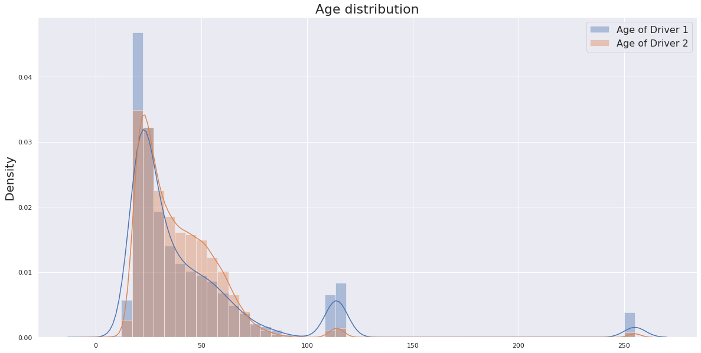
Age distribution
Here we can observe that most of the
accidents occur between the
age group 17 to 85
outliers

Slide 8
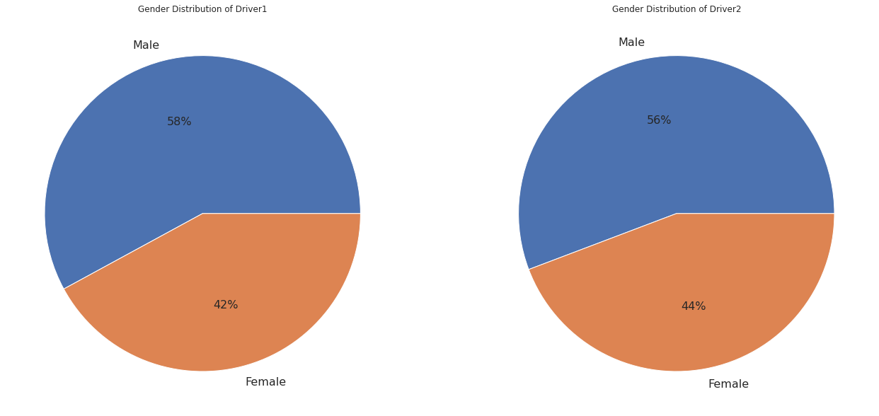
Gender distribution

Slide 9
Data Cleaning

Slide 10
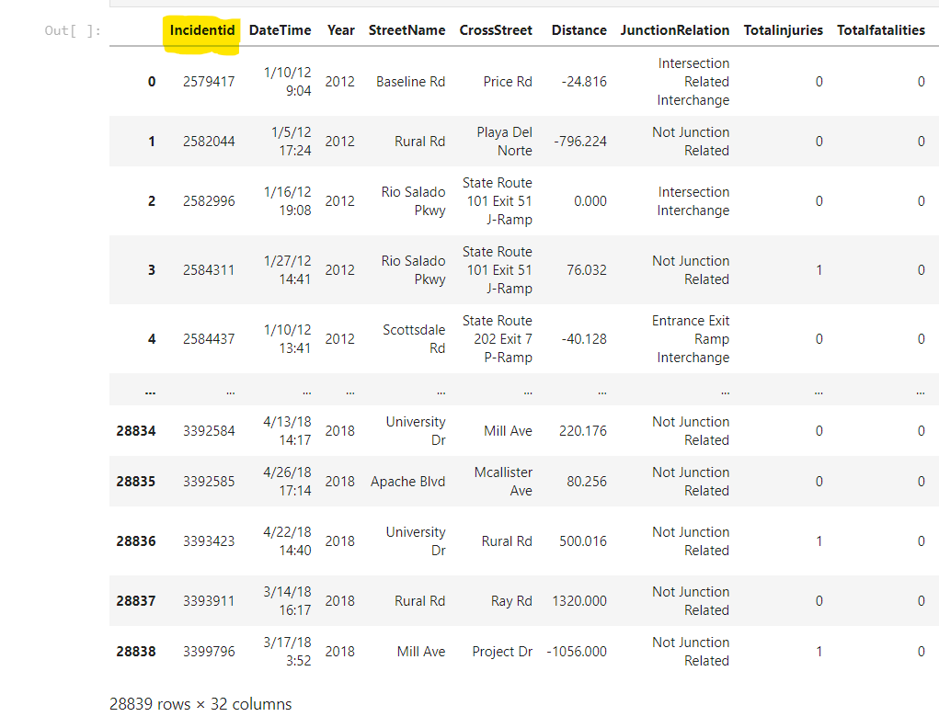
Data Cleaning
Incident id has been removed because they comprise of unique values that is not helpful for the analysis.

Slide 11
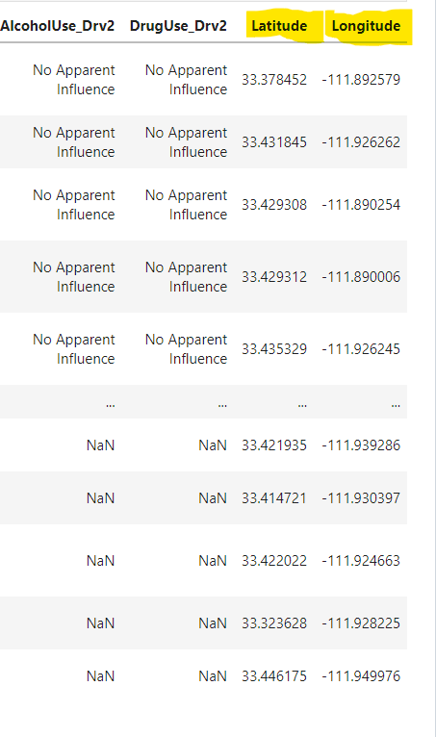
Data Cleaning
Longitude and latitude columns are removed because the values are clustered together and its difficult to interpret a map from it.

Slide 12
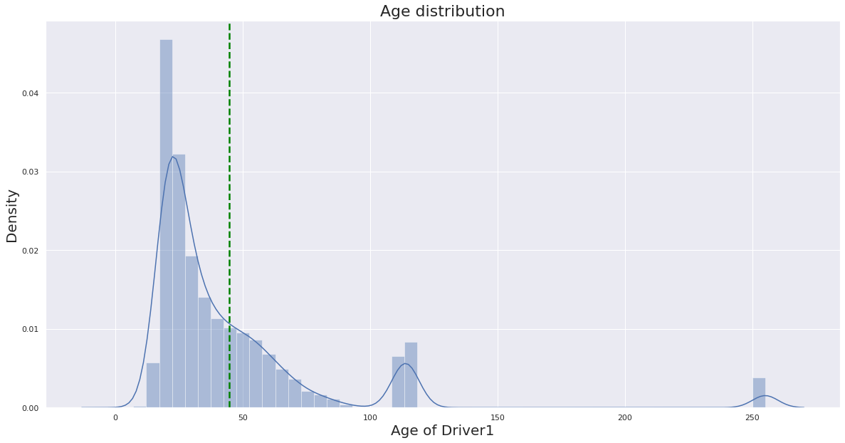
Data Cleaning
The data set that comprised of outliers has been cleaned and removed.
Outliers

Slide 13
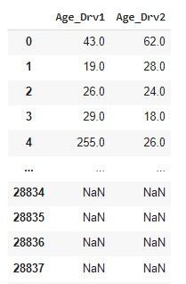
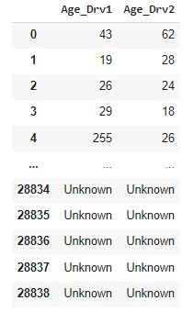
Data Cleaning
Replaced “NaN” with “unknown” to deal with the missing value.

Slide 14
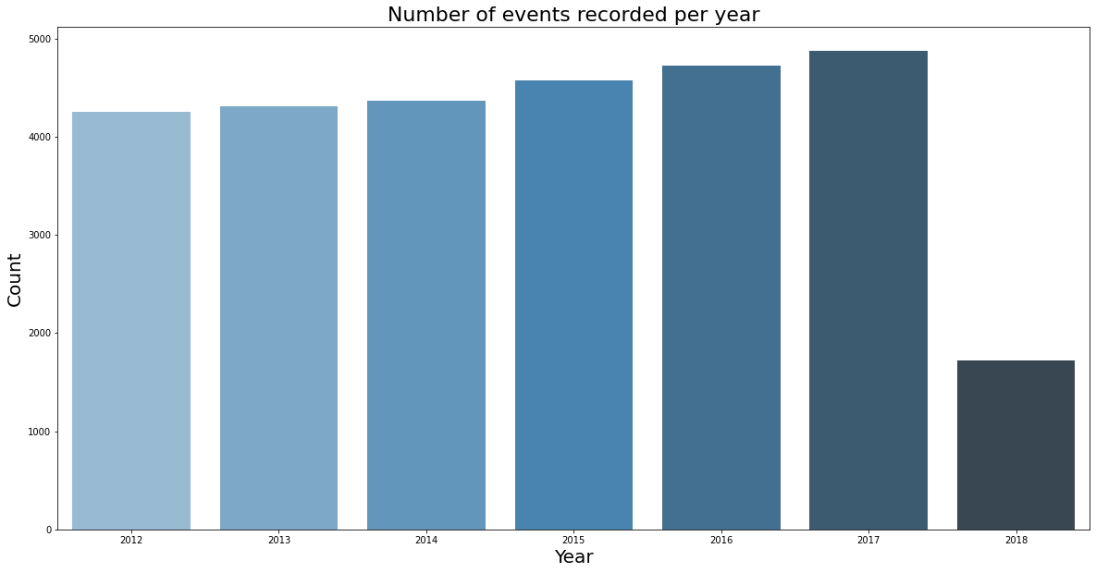
Data Cleaning
Removed insufficient observations of year 2018.

Slide 15
Data Transformation

Slide 16
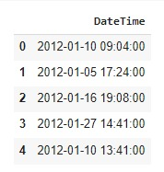
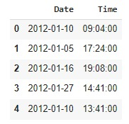
Data Transformation – Split DateTime Column
Since the date and time column is merged, we’re splitting the date and time column for a better understanding on when the accident happens the most.

Slide 17
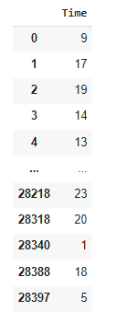
Data Transformation – Hours and Minutes to Hours
To look at the bigger time frame here we are disregarding minutes

Slide 18
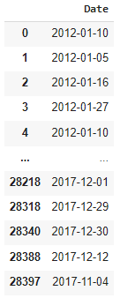
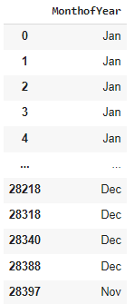
Data Transformation – Derive new column for months
Derived new column “MonthofYear”

Slide 19
Data Analysis

Slide 20
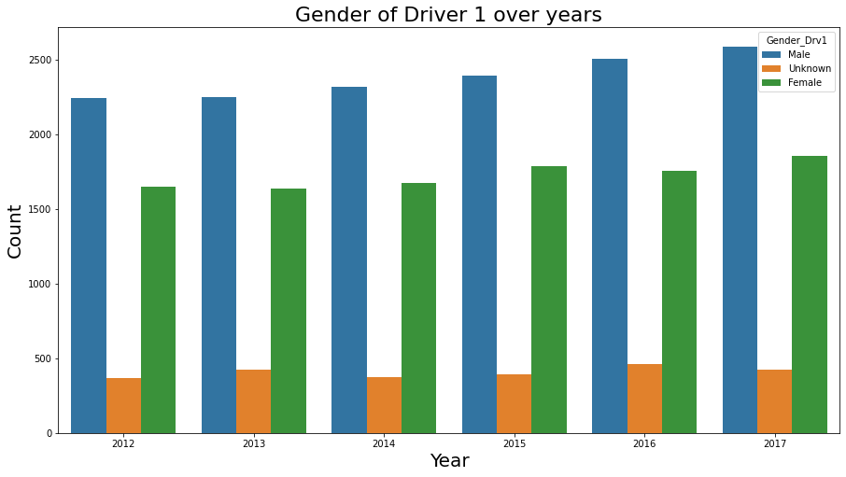
Analysis - Gender
Here we can see that males tend to get into more accidents than females.

Slide 21
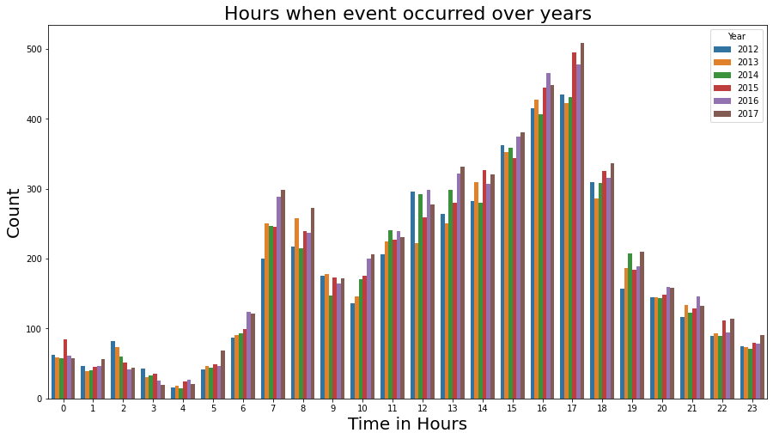
Analysis – Time Frames
It can be observed that most of the accidents are happening during late noon and early evenings between 14:00 to 18:00 hours.

Slide 22
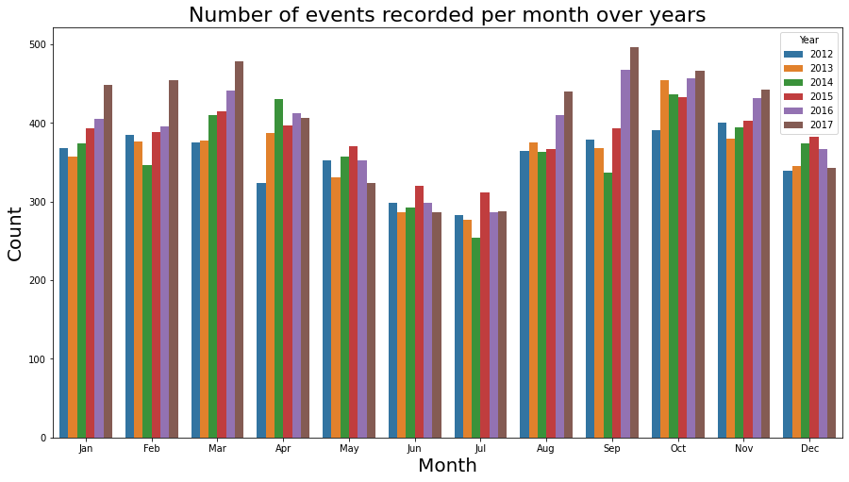
Analysis – Events
It can be observed that most of the accidents occurred in the month of September, whereas the month of July recorded the least number of accidents.

Slide 23
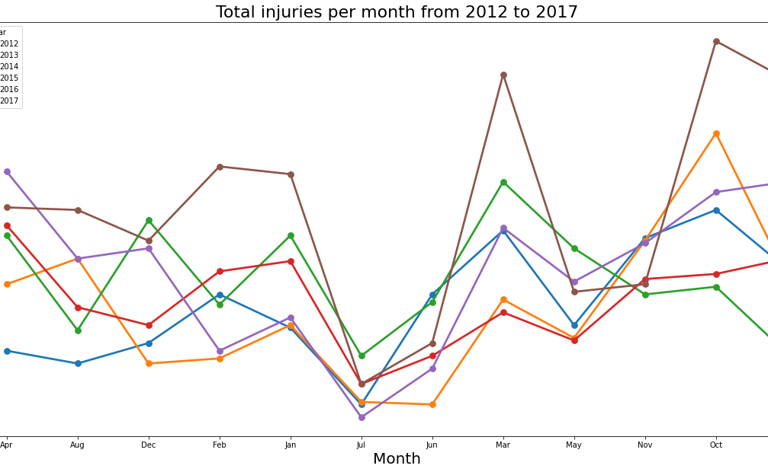
Analysis - Injuries
It is observed that number of injuries somewhat follows the pattern of number of crashes.

Slide 24
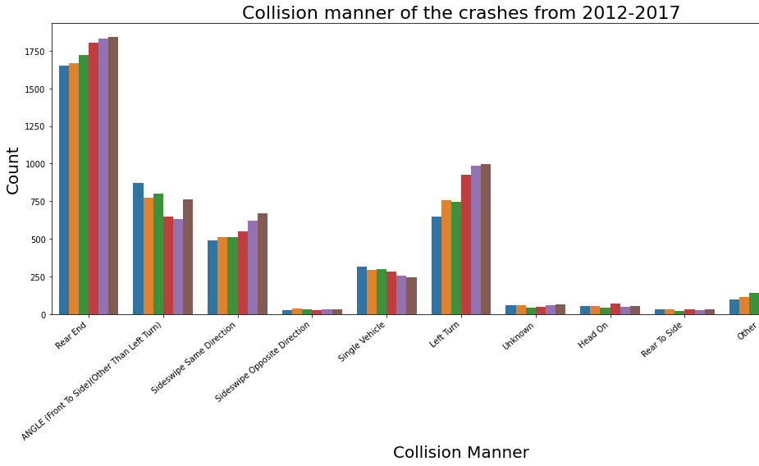
Analysis – Collision Manner
Here we can see that most of the collisions in the accidents were on the rear end.

Slide 25
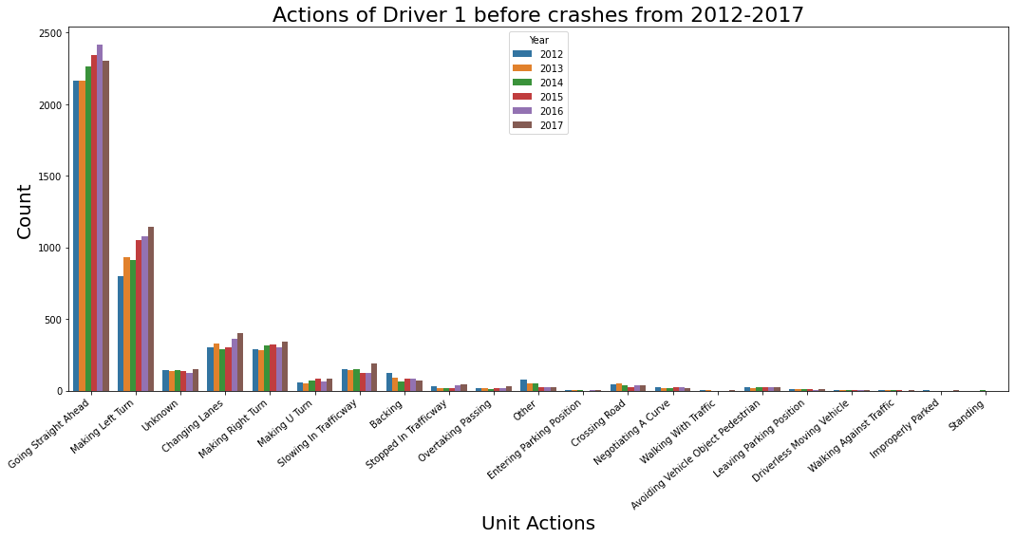
Analysis – Actions
Highest number of accidents happened while going straight
It is interesting to note that ‘Making Left Turn’ was the second highest accident causing action for Driver 1

Slide 26
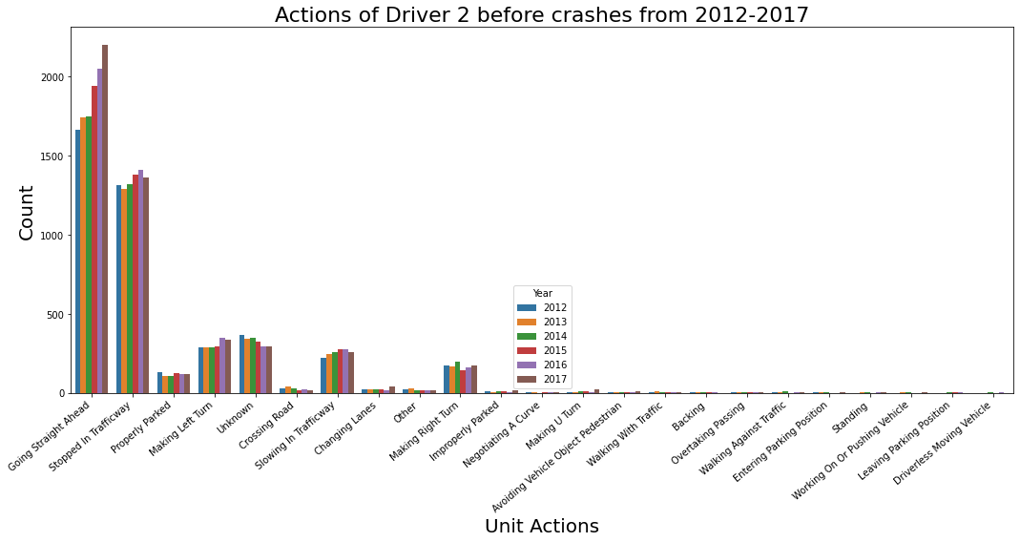
Analysis – Actions
Highest number of accidents happened while going straight
It is interesting to note that ‘Stopped in Traffic way’ was the second highest accident causing action for Driver 2
Hence from the previous and current slide it is seen that most accidents happened while one of the vehicle was stationery

Slide 27
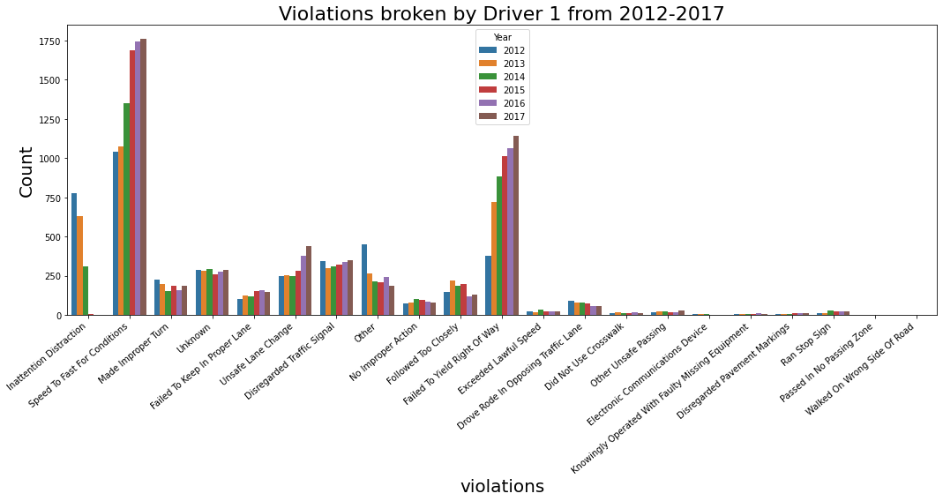
Analysis – Violations
Highest number of violations broken was speedy driving
It is interesting to note that ‘Failed to yield Right of Way’ was the second highest accident causing violation for Driver 1 and it is steadily increasing over the years

Slide 28
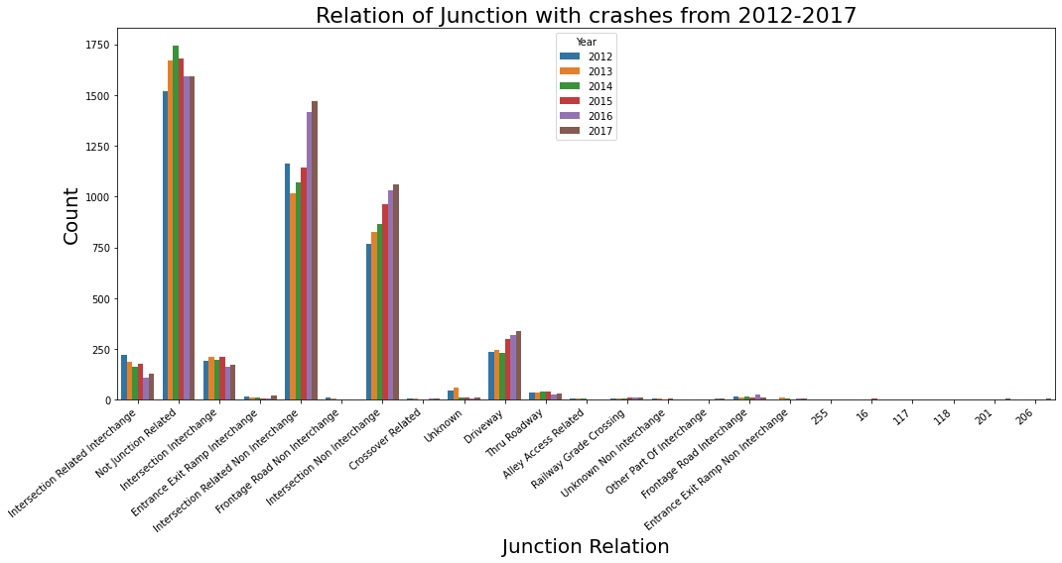
Analysis – Junctions
It can be seen from the graph that most of accidents happened were somewhat related to intersection and driveway
It is also interesting to note that most accidents were not related to junctions

